Slide 1
Εισαγωγή στη γλώσσα προγραμματισμού R
(Πρακτικό Εργαστήρι)
Irene-Angelica Chounta
Computational Methods in Modeling and Analysis of Learning Processes (colaps)
Department of Computer Science and Applied Cognitive Science (INKO)

Slide 2
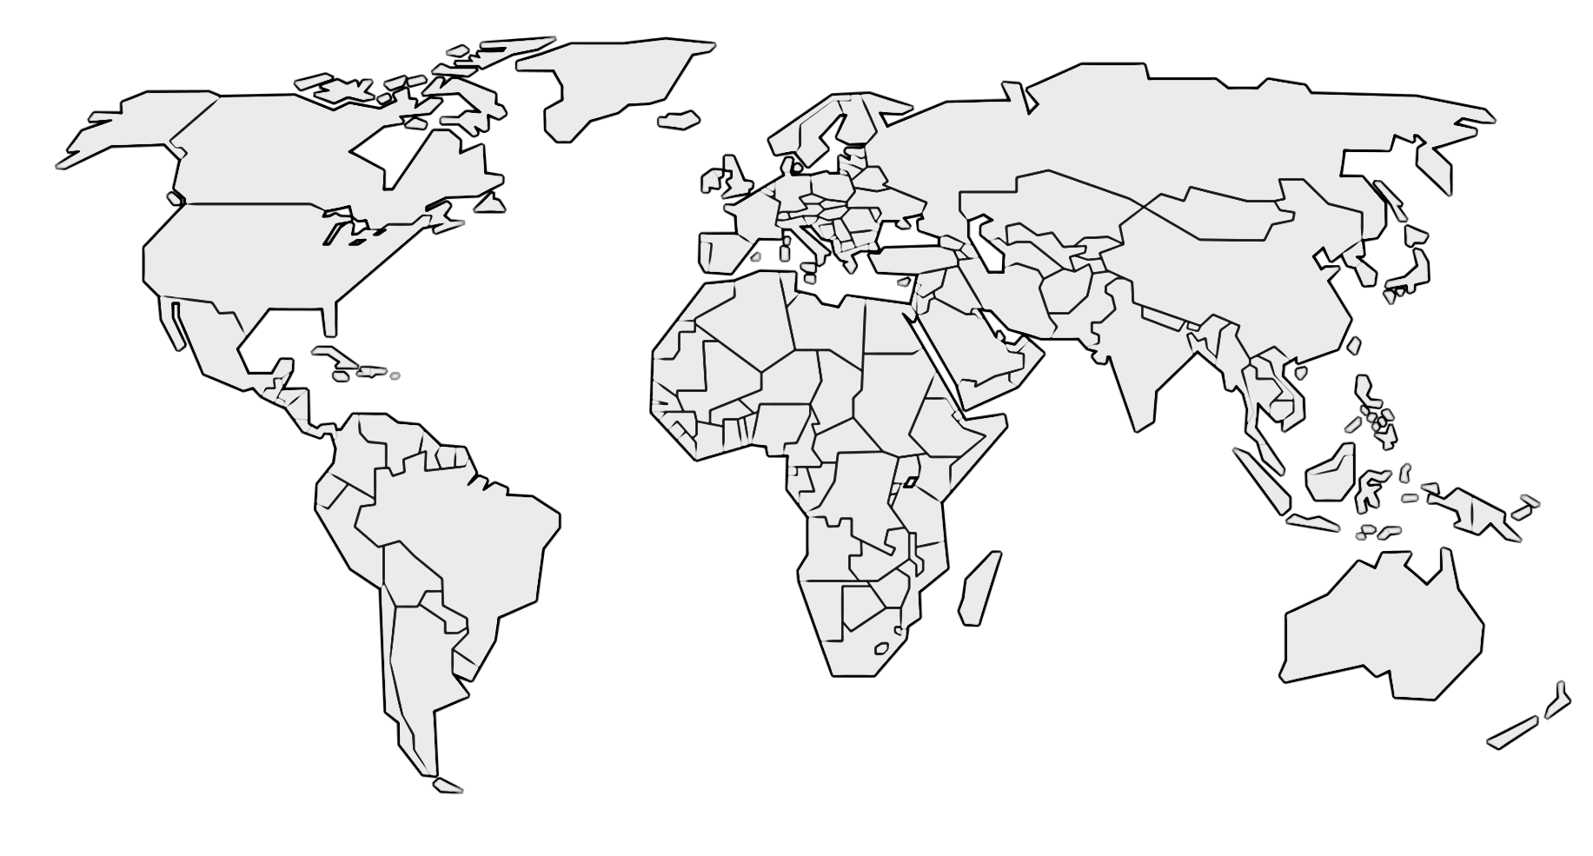





Hello world
Electrical and Computer Engineering, University of Patras - PhD in Human-Computer Interaction and Educational Technologies (2014)
Postdoctoral Researcher, University of Duisburg-Essen
Postdoctoral Researcher, Carnegie Mellon University
Assistant Professor, University of Tartu
J.Professor, University of Duisburg-Essen

Slide 3

Digital Technologies & Education

Slide 4

Digital technologies & Education

Slide 5
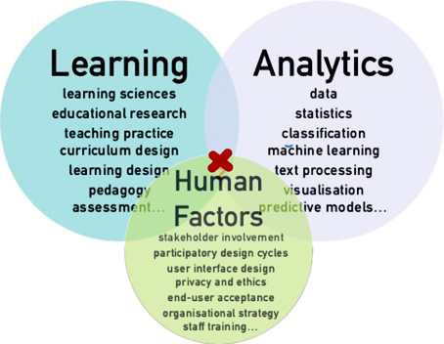
Learning Analytics

Slide 6

Και τι θα κάνουμε σήμερα?
Ανάγνωση δεδομένων και βασική επεξεργασία
Ανάλυση δεδομένων με βασικές τεχνικές Επεξεργασίας Φυσικής Γλώσσας (Natural Language Processing, NLP) και Ανάλυσης Κοινωνικών Δικτύων (Social Network Analysis, SNA)
Οπτικοποίηση δεδομένων και παρουσίαση αποτελεσμάτων

Slide 7
Πρώτα βήματα…
Περιβάλλον -> rstudio
Δεδομένα -> https://tinyurl.com/ggc-data
Τρόπος εργασίας….?

Slide 8
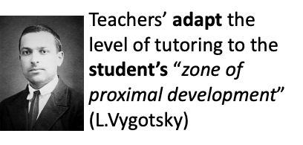
Personalized, adaptive tutoring

Slide 9



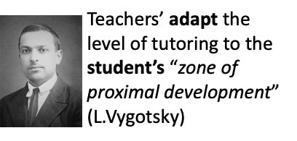
Modeling learning
Challenge: Using students’ practice data to computationally model their cognitive, social and affective state
Machine-learning for
student modeling[1]
[1] Chounta, I.A. (2019). Combining Machine Learning and Learning Analytics to Provide Personalized, Adaptive Scaffolding. In Proceedings of 13th International Conference on Computer Supported Collaborative Learning (CSCL) 2019

Slide 10

Modeling learning
NLP for Learning Artifacts Analysis over time
Bayesian Networks for Cognitive State Transitioning
Assessments for cognitive, affective and physiological state of individual students
SNA for Social Skills
Pattern recognition and Signal Processing
for Personal traits and Well being

Slide 11
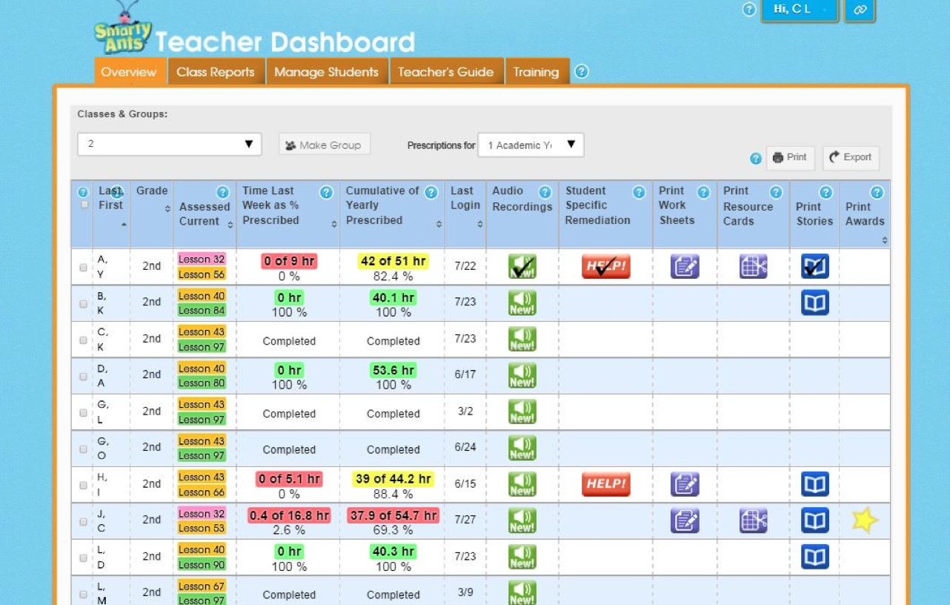
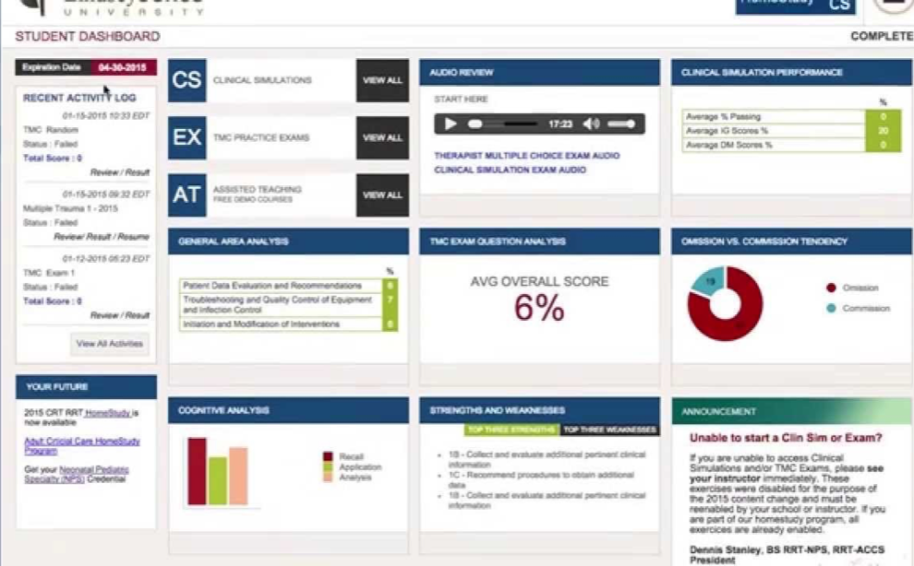
Learning Dashboards, Visualizations, Operation Centers

Slide 12
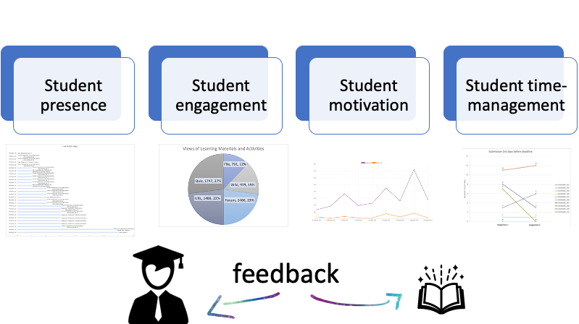
Learning Dashboards, Visualizations, Operation Centers

Slide 13
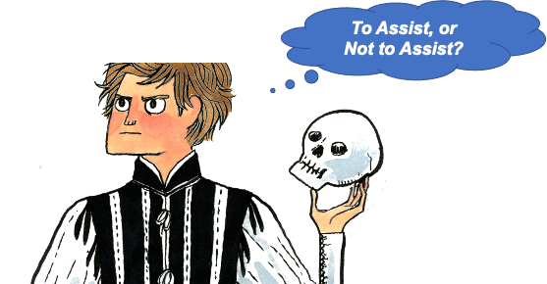
From Analytics to Interventions
Assistance Dilemma (Koedinger, Pavlik, McLaren, & Aleven, 2008)
The problem of choosing whether to intervene to support a learner in accomplishing some activity and how

Slide 14
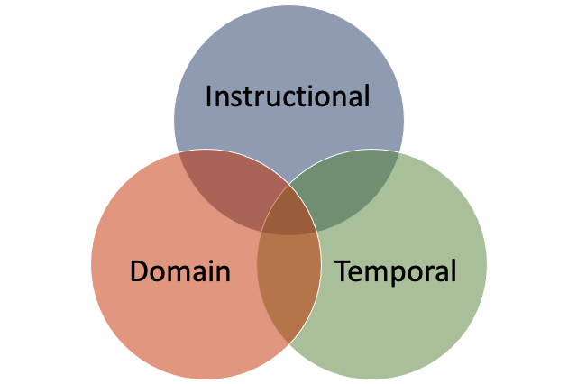
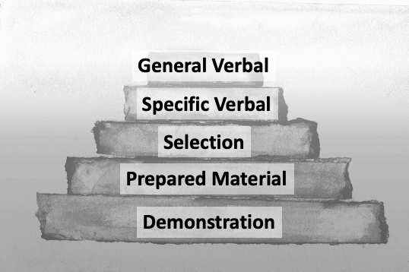
Synthesizing Feedback
Face-to-face teaching strategies (Wood, 1976)
Contingent Tutoring (Wood, 2003)
Notes:
General Verbal Intervention: “Call to Action”
Specific Verbal Intervention: “Warn What to Look for”
Specific Verbal Intervention with Non-verbal Indicators: Physical Involvement
Prepared Material
Demonstration
a.Instructional: Methods and materials used
Example: Open-ended questions vs. Memorizing
b. Domain: Progression or area of knowledge
Example: Teaching addition before multiplication
c. Temporal: Providing feedback when needed
Example: Elicitation vs. Telling

Slide 15
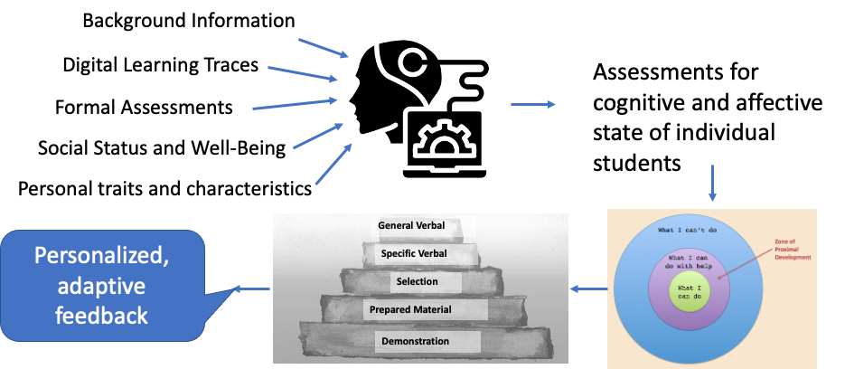
Personalized, Adaptive Feedback

Slide 16
Hands-on
a. A closer look at 4 scenarios;
b. Review, Reflect, Design (feedback)
OPEN DISCUSSION
For each of the 4 scenarios:
•What additional information I would like to have to assess situation
•What factors should be emphasized in the feedback [e.g. personalization, motivation, content, self-reflection]

Slide 17
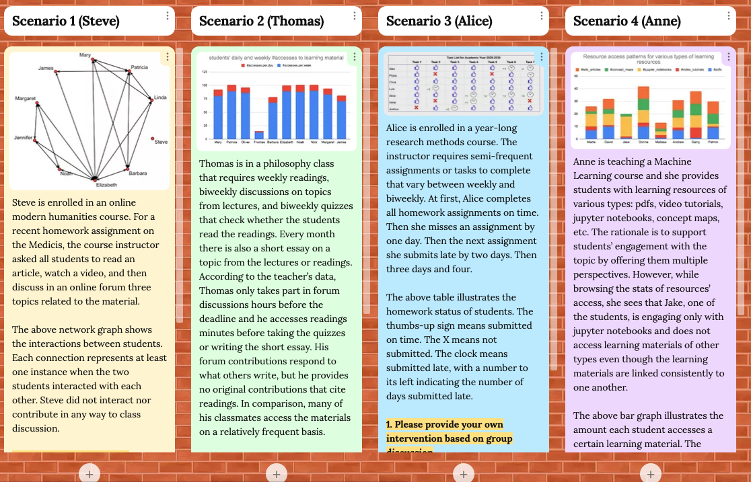
Hands-on
consent form (https://forms.gle/cNuDHSrykoQyQfuv6)
https://tinyurl.com/mv3etdhs

Slide 18
Hands-on
https://tinyurl.com/mv3etdhs

Slide 19

Learning in 21st century

Slide 20
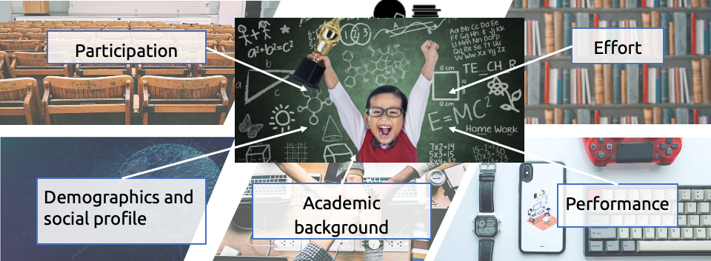
Learning in 21st century

Slide 21

Get in touch!
happy to answer your questions
https://www.uni-due.de/colaps/
irene-angelica.chounta@uni-due.de

